Slide 1
1. Introduction
The Magneto hydrodynamic (MHD) generator is a device that converts thermal energy of a fuel into electrical energy.
In 1932, Michael Faraday, demonstrated the experiments that there is an electromagnetic induction in a current carrying conductor moving the earth magnetic field.
In 1938, U.S scientist Bela Karlovitz is the first one developed the Magneto hydrodynamic generator.
In India, the MHD generator program is undergoing in Thiruchirappalli in collaboration with Bharat heavy electrical limited (BHEL).

Slide 2
The meaning of MagnetoHydro Dynamics

Slide 3
2. Lorentz force law
The Lorentz force law is the basis for the Magnetohydrodynamic generator
The lorentz force law states that the charged particle expreinec a force when is moving in the electromagnetic field. This force can be explained as
F= Q (v xB)
Where, F is the force acting on charged particl.
Q is the charge of the particle
V is the velocity of particle
B is the magnetic induction

Slide 4
3. Fraday’s law
When a charged partcile moving in a magnetic field, it expreience the retarding foce as well as produce voltage. This is the basis of Faraday’s law.
S
Hot gaseous conductor
V
Output current
N

Slide 5
4. Principle, construction and working of Magneto hydrodynamic generator (MHD)
Principle
The principle of Magnetohydrodynamic generator is based on Lorenz law and faraday's law.
In this system, the hot ionized gaseous conductor (working fluid) is passed into the high magnetic field and thereby the current is produced. By placing suitable electrodes (Anode and cathode) inside the chamber, the output load is taken through the external circuit.

Slide 6
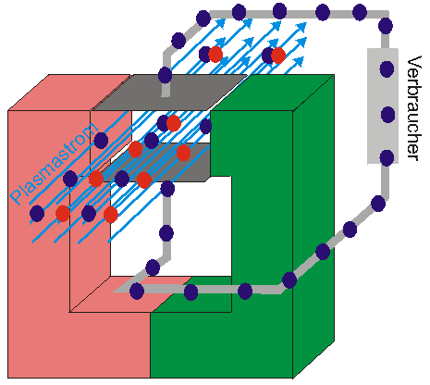

Slide 7
Construction
Thermal resistance sealing
Water cooler
Magnet
S
N
combustion
Chamber
Working fluid
Electrode
V
Load output
Ionized Gas
Inlet
Stream out
Nozzle

Slide 8
Introduction
Lorentz force law
Fraday’s law
Principle, construction and working of Magneto hydrodynamic generator (MHD)
Advantages, disadvantages and applications

Slide 9
MHD generator consist of a Combusion chamber and generator chamber.
The fliud conductor is passed into the combusion chamber where they are ionized at very high temperature.
There is a nozzel through which the ionized gas pass into the generator chamber.
The generator chamber consist of powerful magnet and a number of oppositely located electrode pair is inserted in the channel to conduct the electrical current generated to an external load.
Both combusion chamber and generator chamber are suurounded by a heat resistance material and water cooler

Slide 10
Working
The gaseous (fluid) conductor is passed into the combustion chamber through inlet.
By using a fuel like oil (or) natural gas (or) coal, the fluid conductor is heated to a plasma state and hence it is ionized.
The temperature in the combustion chamber is around 2000°K to 2400°K.
The heat generated in the combustion chamber removes the outermost electrons in the fluid conductor.
Therefore, the gas particle acquires the charge

Slide 11
The charged gas particles with high velocity enters into the generator chamber via nozzle.
The positive and negative charge moves to corresponding electrodes (anode and Cathode) and constitute the current.
In generator chamber, based principles of Faraday’s law, the high velocity ionized conducting gas particles experience the magnetic filed at right angles to their motion of direction and hence the potential (current) is produced.
The direction of current (Potential) is perpendicular to both the direction of moving gas particle and to the magnetic field.

Slide 12
Potential (E)
The diagram shows the direction of charged particle, magnetic field and the current produced
All three field are perpendicular to each other
90°
Ionized gas (Q)
90°
Magnetic field (B)

Slide 13
The electrodes are connected to an external circuit to get a load output.
The current produced in the MHD generator are direct current (DC)
This DC current can be converted into alternative current (AC) using an inverter attached with the external circuit.
In MHD generator, the seeding materials such as potassium and cesium are used to reduce the ionization temperature.
These seeds are mixed with fuel material such as natural gas and coal.

Slide 14
The overall efficiency of MHD generators are about 50 to 60 %.
The electrode are made generally using high temperature ceramic materials such as carbides (SiC, ZrC, MbC), bromides (ZrB₂, TiB₂, LaB₂) and silicides (WS and MOSi₂ ).

Slide 15
5. Advantages, disadvantages and applications
Advantages
The on and off time is about second.
There are no moving parts, it is very reliable to use.
The MHD generator has high thermal efficiency
It is a direct conversion device.
They have a better fuel utilization
It can produce large amount of power
The size of the pant is small

Slide 16
Disadvantages
They need high pure superconductor.
Working temperature is very high as about 200°K to 2400°K.
The loss of power if very high
The components get high corrosion due to high working temperature.

Slide 17
Application
The MHD generators are used to power submarines and aircrafts.
Electrical power production for domestic applications
They are used in a pulsed detonation rocket engine (PDRE) for space application
They can be used as power plants in industry and uninterrupted power supply system

